Slide 1

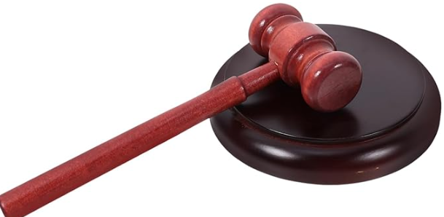
DUTIES AND RESPONSIBILITIES OF THE POST COMMANDER
INDIANA
Updated: August 2026

Slide 2

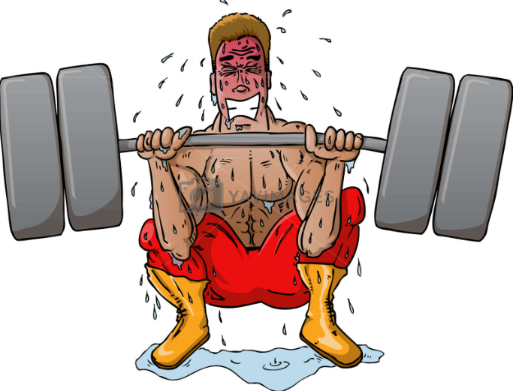

The duties and responsibilities of a Post Commander are extensive, and the following period of instruction by no means encompasses everything you need to know to be successful. This course is an attempt to provide a Post Commander with some BASIC working knowledge and understanding on leading a VFW Post.
When properly executed, “Post Commander” …. Is the hardest and most fulfilling job in the VFW.

Slide 3

First you will need to familiarize yourself with the following:
-Current VFW Congressional Charter, Bylaws, Manual of procedure and Ritual.

Slide 4

-Department and Post Bylaws.
-Department and Post Club/Canteen Rules, and Standard Operating Procedures (SOP) if applicable.

Slide 5
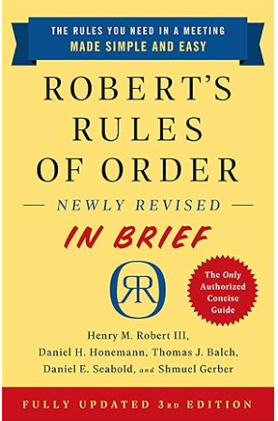
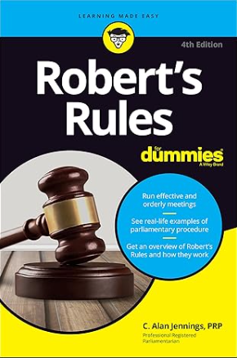
Running Monthly Meetings:
Robert’s Rules of Order
-Know how to handle motions.
-Basic parliamentary procedure.

Slide 6


Know when to use the gavel and when to salute:
One rap calls attention or seats the body when standing
Two raps of the gavel calls everyone to standing attention

Slide 7

Prepare a written guide or use the VFW Ritual to run a proper meeting.
Two types of meetings –
-Traditional: which requires the reciting of the Purposes of the VFW, Section 230102 of the Charter, and involves the proper initiation of new members and other events.
-Contemporary: which omits the recital of Section 230102 of the Charter, along with a few other sequences of events. (New member muster, Remember National Home, other Committee Reports)

Slide 8



Conduct your meeting from a standing position, preferably at a podium. Position of authority. (Do not sit at a table)
Only official VFW caps are to be worn. An Alternative Cap is available for purchase at the VFW Store. Only members may wear it during a Post or District Meeting (Not Officers).

Slide 9

Properly initiate any new members. (If applicable)
Ensure accurate minutes are taken
Ensure General Orders are reviewed

Slide 10


The Post Commander is responsible for ensuring the Post participates in the following programs:
Voice of Democracy
Patriot’s Pen
Teacher of the Year (If Required)
Scout of the Year (If Required)
Buddy Poppy

Slide 11


Community Service
Police/Fire/EMT of the year
VFW Day of Service
VMS Donation
Department Commanders Special Project

Slide 12
In Addition:
You must know your membership status, and the resources available from the State/Department and National Membership teams
You are responsible for the Post Inspection, not the Quartermaster (QM)
Ensure your Post Officers know and understand their various roles and duties
Ensure you and your officers attend all District and State/Department meetings, conferences, and conventions, along with the annual School of Instruction
If a Post misses 2 District Meetings in a row the Post Commander will/could be relieved (Based upon that years current State Commanders Guidance)

Slide 13


Miscellaneous:
Ensure the Election Report is completed and properly filed, to include Phone #s and email addresses
Ensure the QM is bonded, along with any others required
Ensure Quarterly Trustee Audit is completed by the Trustees, not the QM
Ensure all fees to the District and State/Department are paid when due
Ensure delegates are elected to the Department and the National Conventions
Ensure deserving members receive awards as set forth in the current Department Awards Update

Slide 14


Ensure that you read all correspondence thoroughly
Work closely with the QM and Adjutant along with all your officers
Ensure you are training your replacement, bring them onboard early and often
No one member has all the answers and that’s why we communicate and assist each other to ensure that the organization is strong across the board

Slide 15
“Look at the Post as a vessel at sea and understand that it takes an entire crew to run the various sections while you are the captain at the helm.”
It is absolutely the hardest volunteer job you’ll probably ever have. So, make it count and do it right!
The buck begins and stops with you!

Slide 16



Slide 17

INDIANA
QUESTIONS?

